Slide 1

Innovation Day Presentation Survey
http://bit.ly/innoday2017

Slide 2
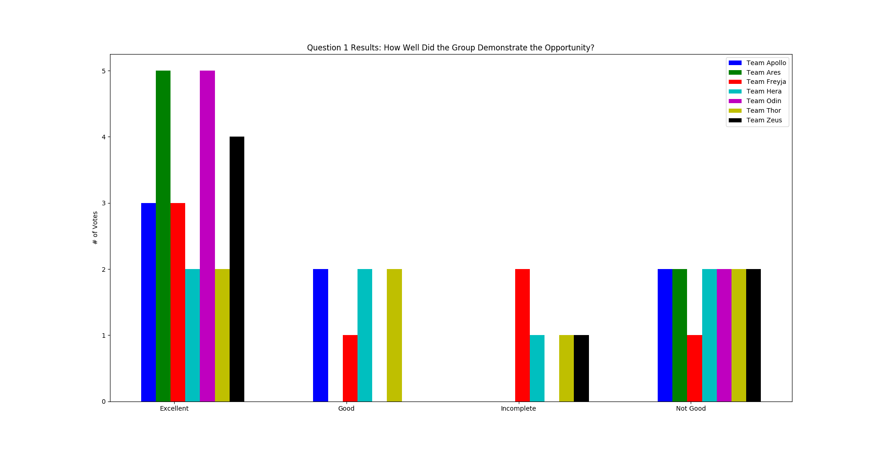
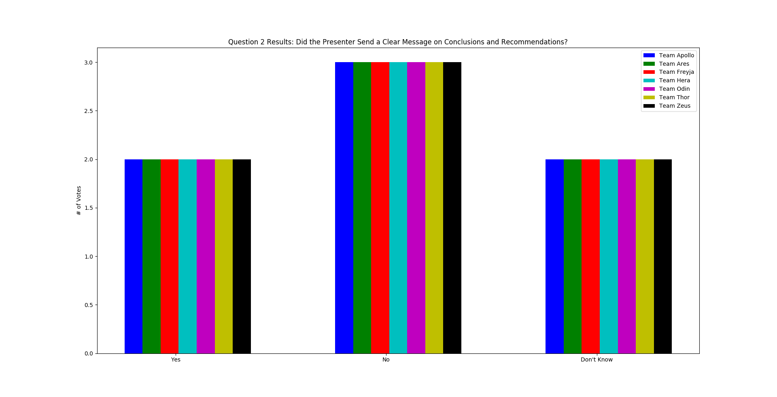
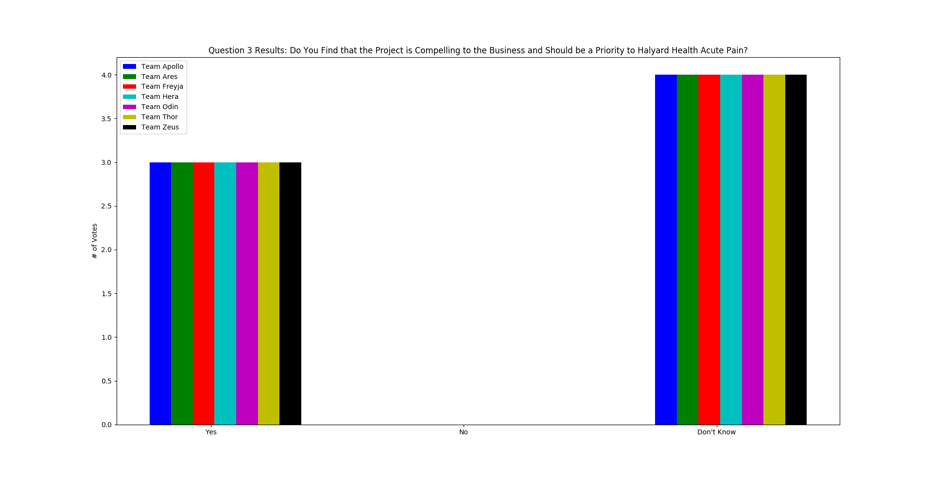
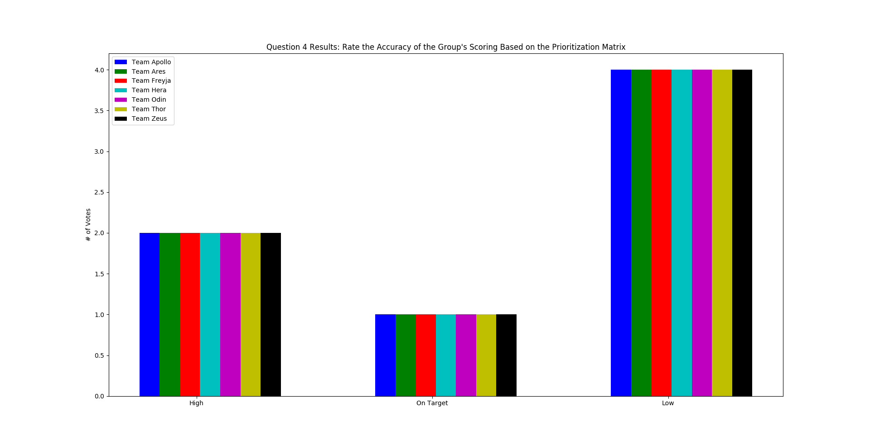
Results
Winner:
1st. Team Ares
2nd. Team Odin
3rd. Team Zeus

